Slide 1
Epinephrine Medication
Name:
Course:
Institution:
Instructor:
Date:

Slide 2
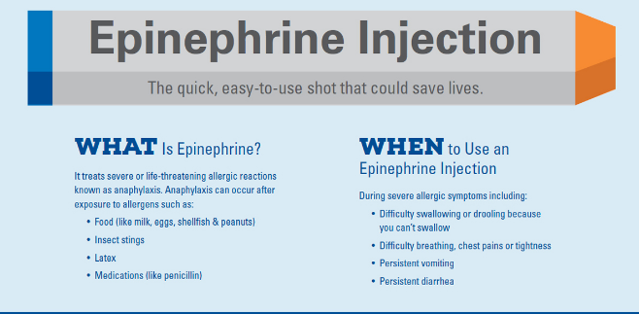
Medication overview
Epinephrine injection is used to treat allergic reactions
Foods
Medications
Insect bites
Epinephrine is classified to a class of medication called the alpha and beta-adrenergic agonists (Potter, et. al., 2016).
Notes:
Epinephrine injection is used to treat allergic reactions caused by foods, insect bites, medication and so on.
Epinephrine is in a class of medications called alpha- and beta-adrenergic agonists (sympathomimetic agents).

Slide 3
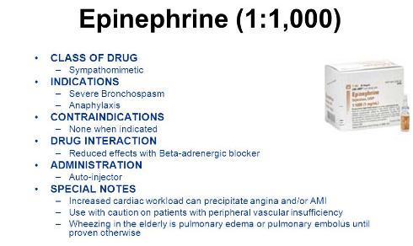
Classification and all indications
Epinephrine is a emergency treatment of allergic reactions (Type I)
It is is available as a single-use 1 mL vial and a multiple-use 30 mL vial (Williams & Wilkins, 2014).
Notes:
Epinephrine is a emergency treatment of allergic reactions (Type I)
Adrenalin® is available as a single-use 1 mL vial and a multiple-use 30 mL vial. The 1 mL vial is for intramuscular, subcutaneous, and intraocular use. The 30 mL vial is for intramuscular and subcutaneous use only, and is NOT FOR OPHTHALMIC USE (Williams & Wilkins, 2014).

Slide 4
Recommended dosing guidelines
Adults And Children 30 kg (66 lbs) Or More
0.3 to 0.5 mg (0.3 mL to 0.5 mL) of undiluted Adrenalin® administered intramuscularly or subcutaneously in the anterolateral aspect of the thigh, up to a maximum of 0.5 mg (0.5 mL) per injection, repeated every 5 to 10 minutes as necessary. Monitor clinically for reaction severity and cardiac effects.
Children Less Than 30 kg (66 lbs)
- 0.01 mg/kg (0.01 mL/kg) of undiluted Adrenalin® administered intramuscularly or subcutaneously in the anterolateral aspect of the thigh, up to a maximum of 0.3 mg (0.3 mL) per injection, repeated every 5 to 10 minutes as necessary. Monitor clinically for reaction severity and cardiac effects (Williams & Wilkins, 2014).
Notes:
Adults And Children 30 kg (66 lbs) Or More
0.3 to 0.5 mg (0.3 mL to 0.5 mL) of undiluted Adrenalin® administered intramuscularly or subcutaneously in the anterolateral aspect of the thigh, up to a maximum of 0.5 mg (0.5 mL) per injection, repeated every 5 to 10 minutes as necessary. Monitor clinically for reaction severity and cardiac effects.
Children Less Than 30 kg (66 lbs)
0.01 mg/kg (0.01 mL/kg) of undiluted Adrenalin® administered intramuscularly or subcutaneously in the anterolateral aspect of the thigh, up to a maximum of 0.3 mg (0.3 mL) per injection, repeated every 5 to 10 minutes as necessary. Monitor clinically for reaction severity and cardiac effects (Williams & Wilkins, 2014).

Slide 5
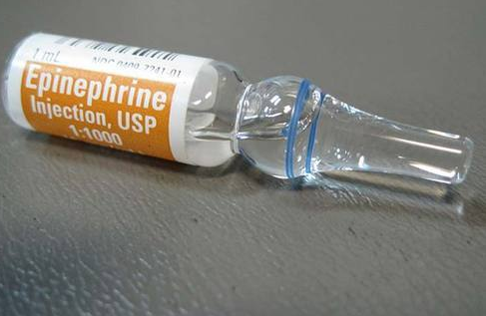
Warnings and precautions
Advise patients or their caregivers about common adverse reactions
Warn patients with a good response to initial treatment
Warn patients with diabetes (Williams & Wilkins, 2014).
Notes:
Advise patients or their caregivers about common adverse reactions associated with the use of epinephrine including an increase in heart rate, the sensation of a more forceful heartbeat.
Warn patients with a good response to initial treatment about the possibility of recurrence of symptoms and instruct patients to obtain proper medical attention if symptoms return.
Warn patients with diabetes that they may develop increased blood glucose levels following epinephrine administration.

Slide 6
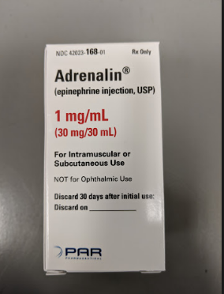
Adverse Reactions
Anxiety, apprehensiveness, restlessness, tremor, weakness, dizziness, sweating, palpitations, pallor, nausea, vomiting, headache, respiratory difficulties, angina, arrhythmias, ventricular fibrillation (may be fatal), rapid rises in BP, cerebral hemorrhage; rare: serious infections at the inj si (Ward, et. al., 2016).
Notes:
Common adverse reactions to systemically administered epinephrine include anxiety, apprehensiveness, restlessness, tremor, weakness, dizziness, sweating, palpitations, pallor, nausea and vomiting, headache, and respiratory difficulties. These symptoms occur in some persons receiving therapeutic doses of epinephrine, but are more likely to occur in patients with heart disease, hypertension, or hyperthyroidism (Ward, et. al., 2016)

Slide 7
Interventions for administration monitoring and effectiveness of medication
Medication should be done wisely to avoid addictive effects
Caution should be taken to patients getting halogenated anaesthetics
The cardiostimulating and bronchodilating effects of epinephrine are antagonized by beta-adrenergic blocking drugs, such as propranolol.
Clinical use data support weight-based dosing for treatment of anaphylaxis in pediatric patients
Epinephrine should not be used to counteract circulatory collapse
njection into the anterolateral aspect of the thigh (vastus lateralis muscle) is the most appropriate location for administration
Do Not Inject Into Buttock
Some patients may be at greater risk for developing adverse reactions after systemic epinephrine administration.
Epinephrine should be administered with caution to patients with hyperthyroidism
Use with caution during labor and delivery (Ward, et. al., 2016)
Notes:
Epinephrine should be administered cautiously to patients taking other sympathomimetic agents because of the possibility of additive effects.
Patients who are concomitantly receiving cardiac glycosides, digitalis, diuretics, quinidine, and other antiarrhythmics should be observed carefully for the development of cardiac arrhythmias.
Administer epinephrine cautiously to patients receiving halogenated hydrocarbon general anesthetics, such as halothane, as coadministration may result in arrhythmias.
The cardiostimulating and bronchodilating effects of epinephrine are antagonized by beta-adrenergic blocking drugs, such as propranolol.
The vasoconstricting and hypertensive effects of epinephrine are antagonized by alphaadrenergic blocking drugs, such as phentolamine.
Ergot alkaloids may reverse the pressor effects of epinephrine.
Epinephrine should not be used to counteract circulatory collapse or hypotension caused by phenothiazines, as a reversal of the pressor effects of epinephrine may result in further lowering of blood pressure (Ward, et. al., 2016)

Slide 8

Patient Education
Inform the doctor of any heart disease or high blood pressure, a heart rhythm disorder, etc.
Inform the doctor of any medications used previously
Before using epinephrine a second time, tell your doctor if your first injection caused a serious side effect (Ward, et. al., 2016)
Notes:
Before using this medication, tell your doctor if you have heart disease or high blood pressure, a heart rhythm disorder, coronary artery disease, Parkinson's disease, diabetes, or a thyroid disorder.
Before using epinephrine, tell your doctor about all other medications you use, especially digoxin (digitalis, Lanoxin), heart or blood pressure medicine, heart rhythm medication, an antidepressant etc
Before using epinephrine a second time, tell your doctor if your first injection caused a serious side effect such as increased breathing difficulty, or dangerously high blood pressure (Ward, et. al., 2016)

Slide 9
Teaching plan
Learning needs
The patients needs to understand how to use the drug in case of allergic reactions
Education goals
To understand the classification of the Epinephrine medication, its use and side effects
Learning outcomes
The patient understands the use of the drug and how well it can be utilized to solve health problems
Notes:
Learning needs
The patients needs to understand how to use the drug in case of allergic reactions
Education goals
To understand the classification of the Epinephrine medication, its use and side effects
Learning outcomes
The patient understands the use of the drug and how well it can be utilized to solve health problems

Slide 10
References
Lippincott Williams & Wilkins. (2014). Study guide for Abrams' Clinical drug therapy, rationales for nursing practice, tenth edition. Philadelphia: Wolters Kluwer Health/Lippincott Williams & Wilkins.
Potter, P. A., Perry, A. G., Stockert, P., & Hall, A. (2016). Fundamentals of Nursing.
Ward, S. L., Hisley, S. M., Kennedy, A. M., & In LoGiudice, B. (2016). Maternal-child nursing care: Optimizing outcomes for mothers, children, and families.

